Slide 1
Dashboard for Covid-19 Surveillance
Using Computer Vision

Slide 2
Proposed Idea
Using a known video surveillance, detect the number of people not wearing any mask
Simultaneously, detect any person sneezing or coughing and alert on the dashboard.
Give various insights on the dashboard which include, real time risk index in the people covered under surveillance, amount of people not wearing any mask, etc.

Slide 3
Mask Detection
We used a pretrained ResNet500 with a fully-connected layer and trained on 678 images of wearing or not wearing a mask.
Accuracy: 98.67%
Framework: Pytorch
Dataset: Medical-Mask-Dataset

Slide 4
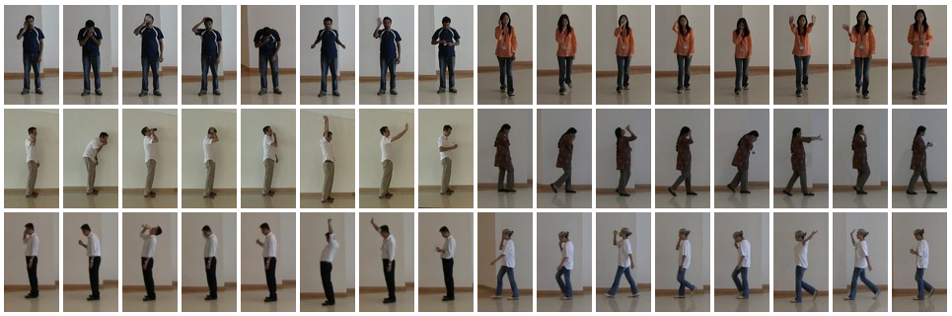
Sneeze Detection
https://web.bii.a-star.edu.sg/~chengli/FluRecognition.htm

Slide 5
The Dashboard
Each of the surveillance camera is tagged to its GPS location while in real time feeding in the data to our model.
Based on the density of potential affected people, each area can be flagged on a map, which can be further integrated to any of the pre-existing apps of the police, health workers and the public.

Slide 6
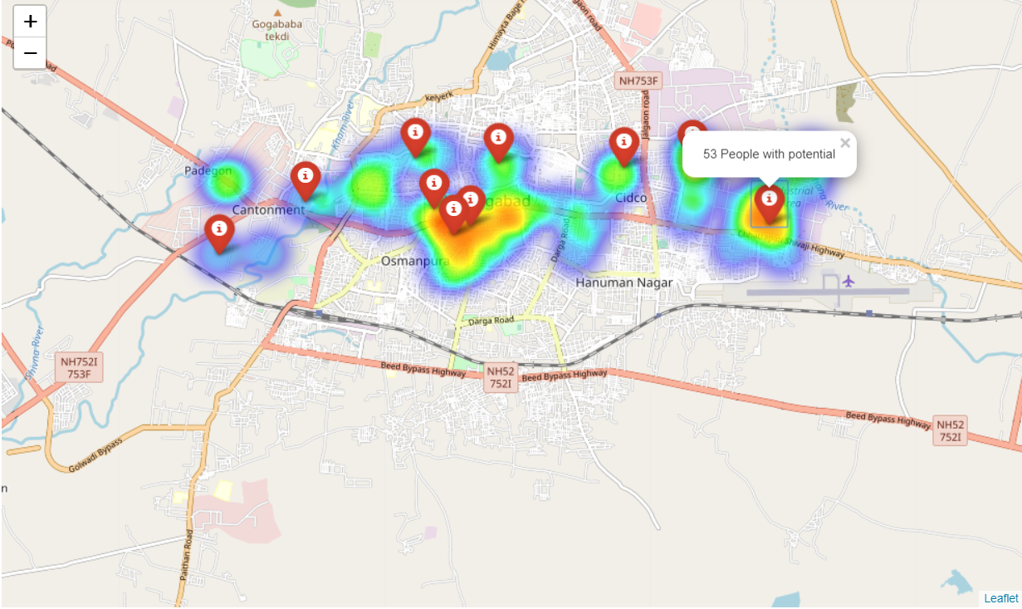
Dashboard Map

